Slide 1
Holy communion lesson 10

Slide 2
S.C. I am aware of other bible stories where Bread holds importance, I recognise why the Eucharist is often called the Bread of Life, I know that each time we take the Eucharist Jesus is with us in a very special way
L.I. We are learning about being nourished by the Bread of Life

Slide 3
Manna in the desert
Let’s hear the story of Manna in the desert.
https://www.youtube.com/watch?v=WYjBa09OGAU
https://www.youtube.com/watch?v=ogfVBP35U-U
When the people of Israel were escaping from Egypt to their own country they had to go across the desert. When they had no food left to eat, God sent them a food like bread (manna). God said to Moses, “I will rain food from heaven for you and you will know that I am the Lord your God.” Without this food the people of Israel would surely have died. God continued to send this food (manna) for forty years. (Exodus)

Slide 4
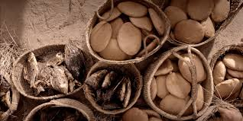
Think back to the bible story of the feeding of the 5,000 (STORY ON POWERPOINT)
Why do you think a large crowd of people followed Jesus into the hills?
How many people had followed him?
How did the people who were listening to Jesus feel at the end of the day?
Who asked Jesus to help?
Who noticed the little boy in the crowd?
What did this little boy give to one of Jesus’ disciples?
What did Jesus do to the food before it was given out to the hungry crowd?
When the 5,000 people were fed, how much food was left over?
What does ordinary bread do for you?
What does Jesus, who is the Bread of Life, do?
What is the difference between ordinary bread and Jesus, the Bread of Life?
Can you name other stories where Jesus blessed and shared food?

Slide 5
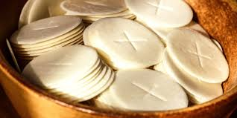
Holy Communion is sometimes called the Bread of Life
Every time we gather together (at Mass) and receive Holy Communion, Jesus is with us in a very special way. It is his Real Presence under the appearance of Bread and Wine. The bread and wine has become the Body and Blood of Jesus which nourishes/feeds us and helps us to live the way God wants for us.

Slide 6
Let’s practise this prayer together
Lamb of God, You take away the sins of the world, have mercy on us.
Lamb of God, You take away the sins of the world, have mercy on us.
Lamb of God, You take away the sins of the world, grant us peace.

Slide 7
Your task
Sacramental children – complete class task 10 in your booklet
Everyone else – complete the Feeding of the 5000 Worksheet
Lamb of God, You take away the sins of the world, have mercy on us.
Lamb of God, You take away the sins of the world, have mercy on us.
Lamb of God, You take away the sins of the world, grant us peace.

